Slide 1

Introduction to deep Learning
Andromeda Institute of Technology

Slide 2
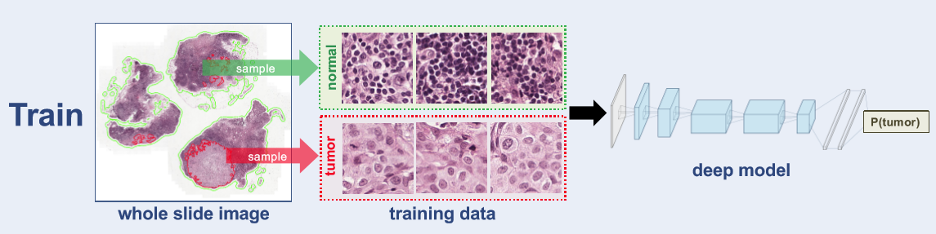
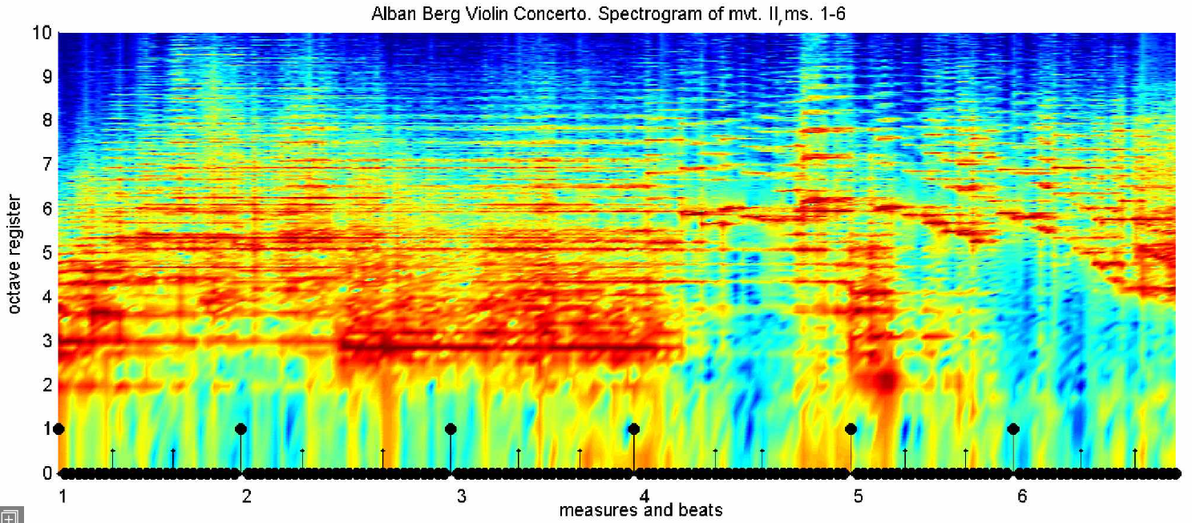
Why deep learning?
Notes:
With ML we normally the whole learning process with features that has been extracted from the data, then we just run models on top of them
Icream sales – temperature
Car price predictor – MPG, Review rating, HP
But in a lot of real world applications this extraction of features can become really really challenging.
Cancer Breast tissue detection
Shazam.
Deep learning is really good at identifying patterns in data, and because of that humans don’t have to worry of identifying features.

Slide 3
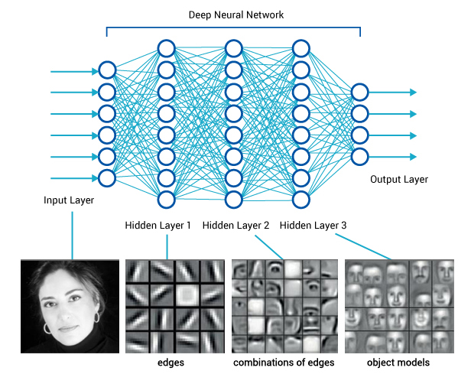
Why deep
learning
Notes:
Let's imagine a different problem:
I want an algorithm that tells me by looking at a picture if a person is a woman or a man.
Humans have high level abstractions learnt over the years, stuff like:
Eye
Face
Woman’s face vs Man’s face.
The Issue is not to know what abstractions to use, but to translate those into numbers for a computer to understand.
Deep learning solves this problem of learning higher model abstractions.
Starting with the raw data, it learns simple abstractions that become more complex with each layer.
Each layer learns a higher abstraction on the input coming from the layer before it.

Slide 4
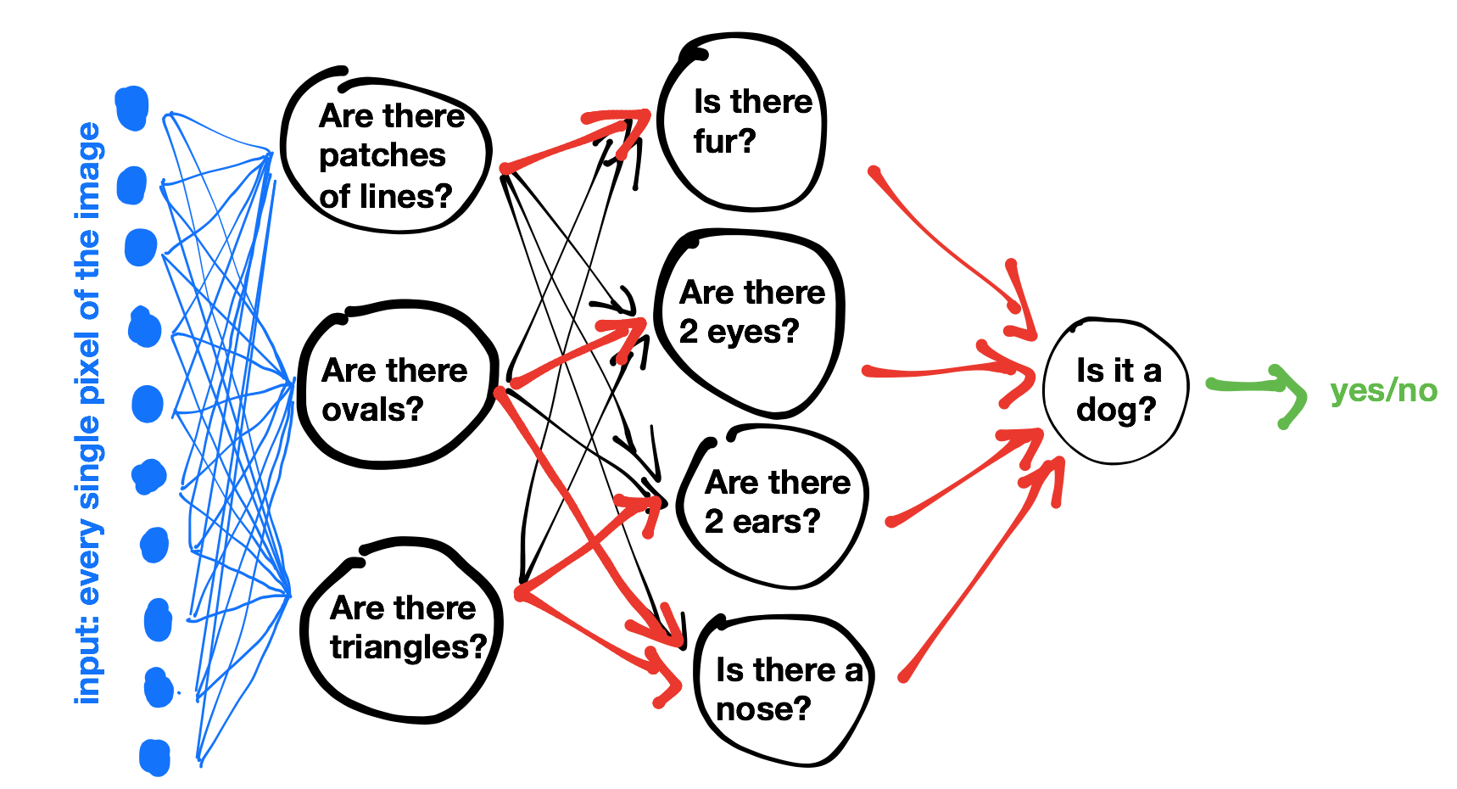

Slide 5
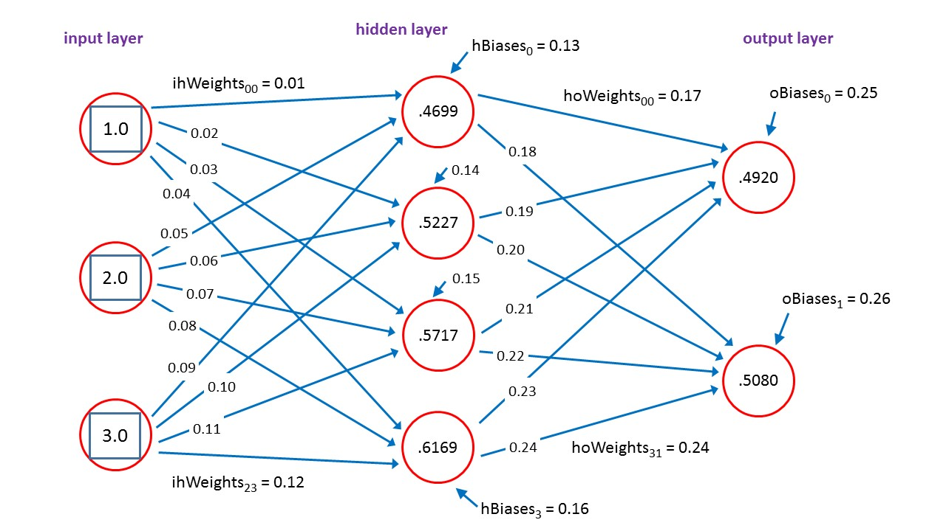
Neural networks and Deep learning?
Notes:
Neural networks = Group of neurons aggregated into layers to perform similar functions. Most common class of deep learning algorithms.
Deep learning = Algorithms that learn what features are actually important. The more complex the graph, the more relationships it can learn.
Neurons = Simplest building blocks that are used to build these neural networks. These are the units that actually do the learning.

Slide 6
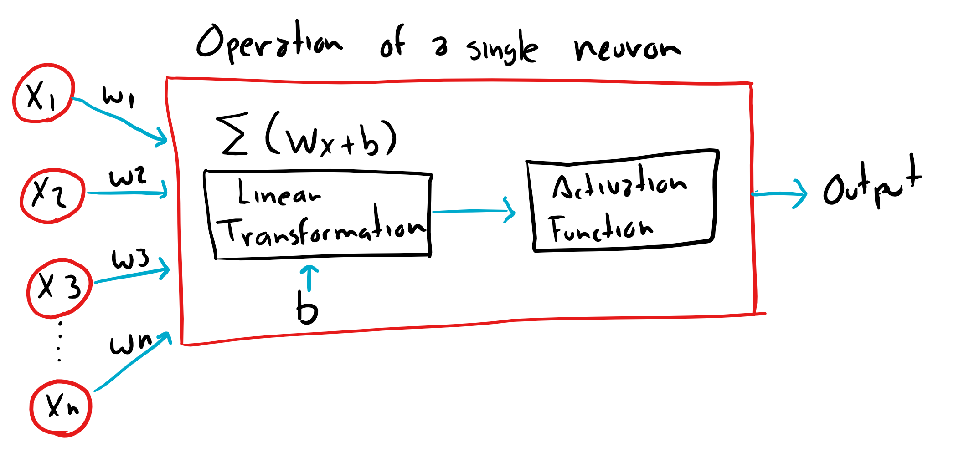
Understanding a neuron
Two simple functions:
A linear transformation: Wx + b
An activation function
Notes:
Neurons can be connected in very complex way, but each neuron only applies two simple function to its inputs:
Linear transformation: (Requires the weights, and the bias) :
W1.. Wn are called weights because they are use to alter how much importance shall we give to input of our data.
b, is called the bias, because it allow us to shift the output of the linear transformation up and down in order to learn the function best.
Where W and b come from?
Weights and biases of individual neurons calculated during training, which is managed for us by CNTK, TensorFlow, etc.
Finding the “best “ values of W and b for each neuron is crucial.

Slide 7
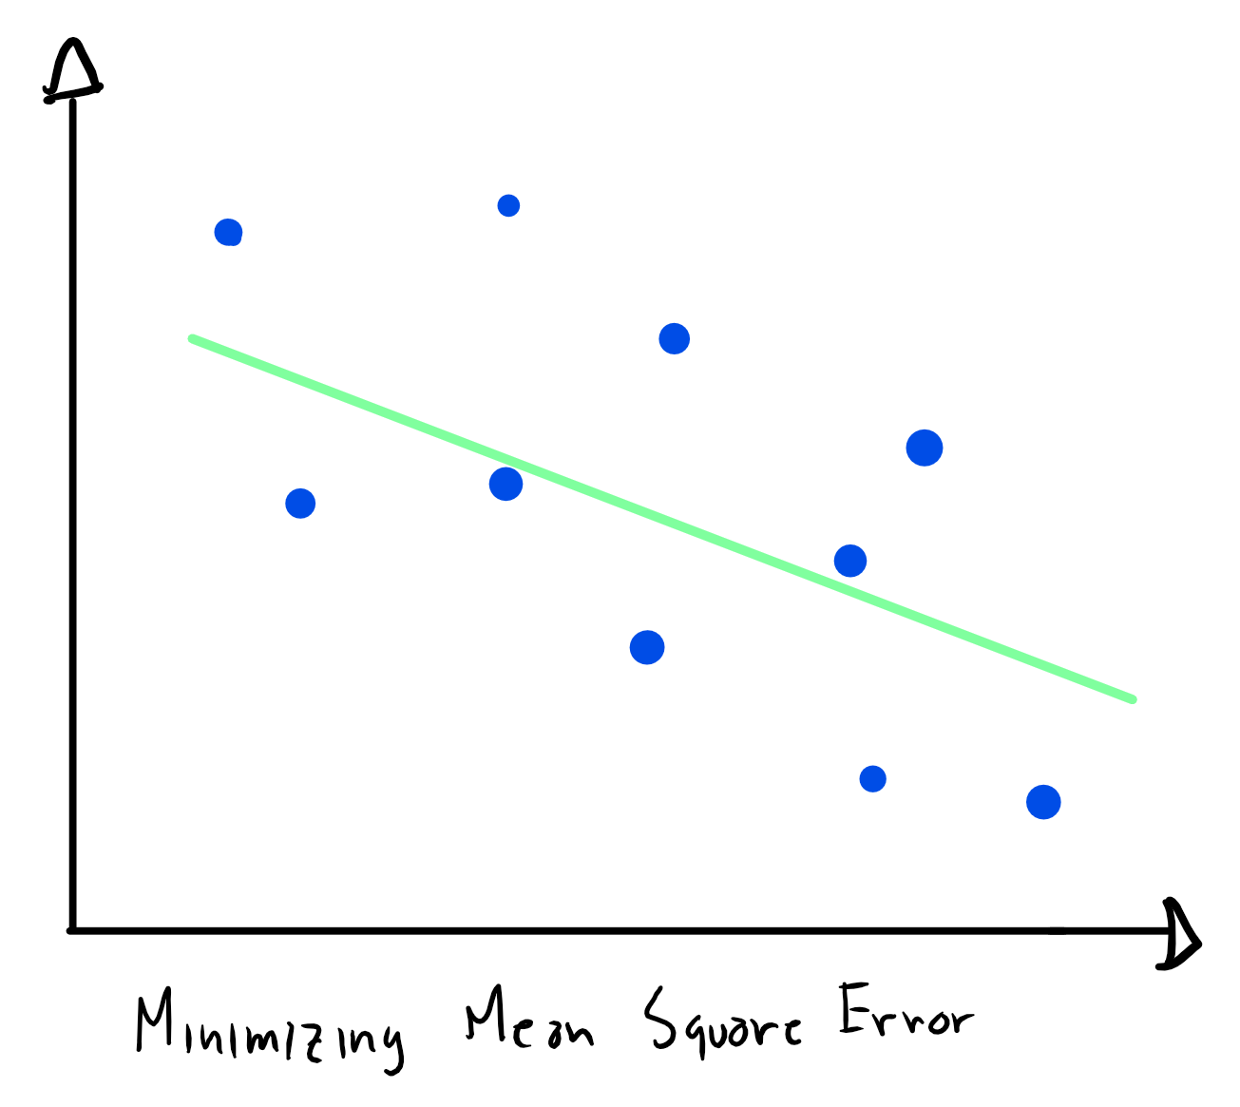
Linear transformation (Y = Wx + b)
Regression with a single neuron
Notes:
In order to do this we need the neuron to finds the best fitting line that goes through that set of points.
Classic regression problem, the dots in blue are the actual data that will be used on the training .
So, the interesting question here is of all possible values of W and b, how the neuron knows how to pick the best W and b?
Because of a process called back propagation.
W and b, are first defined randomly by the algorithm, once this is done, the Mean Square Error is calculated (the mean of the square differences between the predicted values and the actual values).
It is going to do this process several times until it finds the smallest possible error.

Slide 8
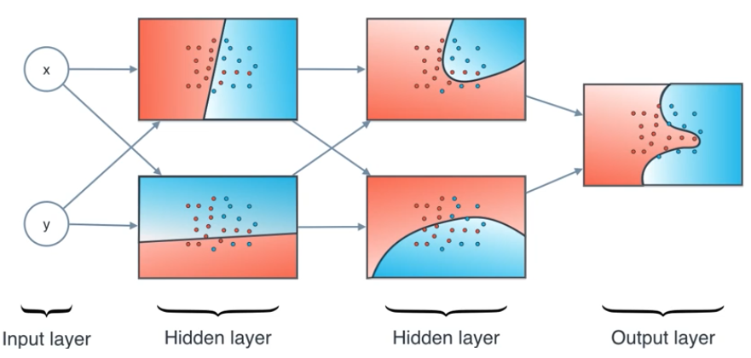
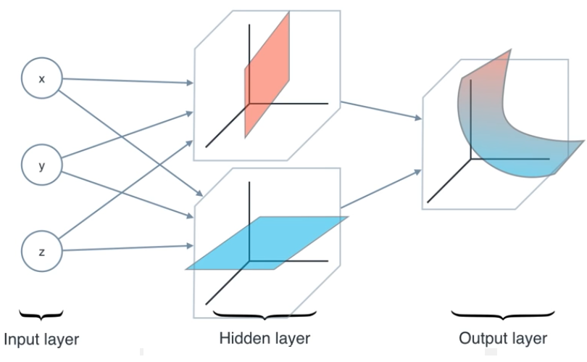
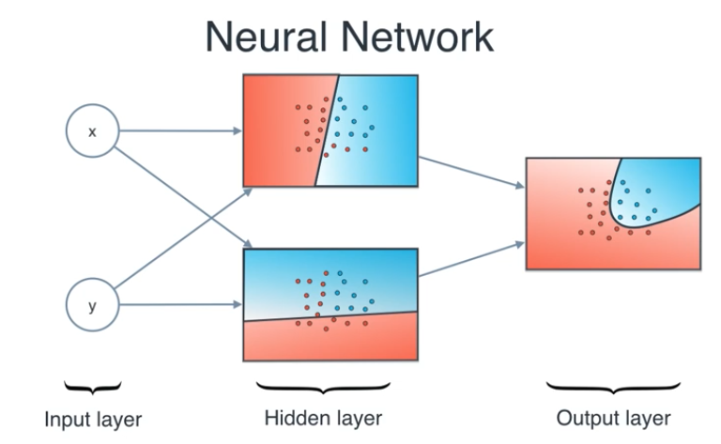
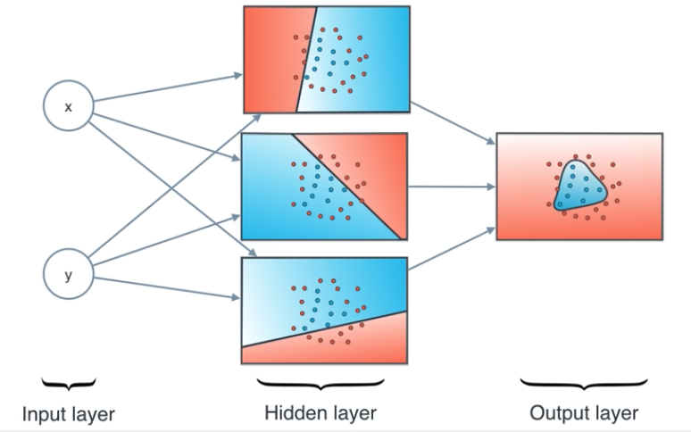
Activation Function
Notes:
The most important thing an activation function does is to introduce non-linear properties into our network,
So you might want to think, why is that useful? Well, pretty much any problem you want to solve can be translated into a non linear function,
and that can be recognizing a song,
Translate English to Spanish,
Or even recognizing a person inside of a picture.
So, we would not be able to solve this problems if our network was only linear, and it would not matter how many hidden layers the model would have, the output would always be linear.
So it can take two linear regions and add them to create a third non-linear region that will be the solution
This is the mental picture I have when I see a neural network:
1. You have your input layer
2. My hidden layer (the lines I am using to cut my regions)
3. Output layer which is the final region I obtained as a combination of those linear region

Slide 9
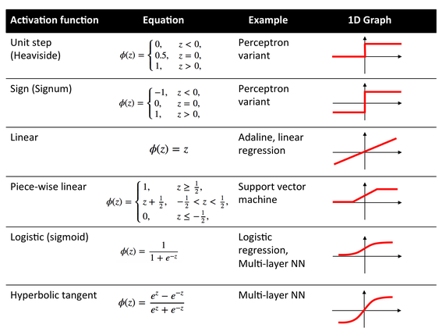
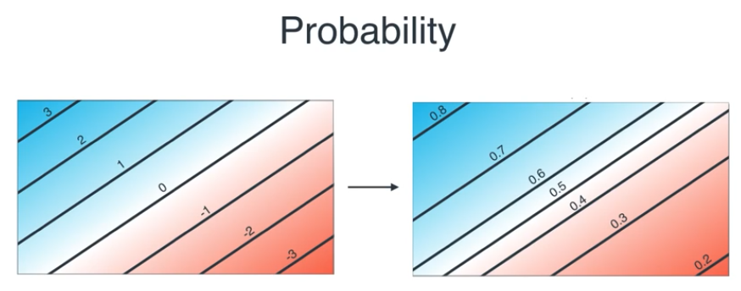
Activation Function
Notes:
So what activation function should I use on my neural network:
The rule nowadays:
Relu for your hidden layers.
Softmax for classification.
Linear activation or Sigmoid for regression.
Relu activation function = f(x) = max (0, x)
As of 2015, the most popular activation function for deep neural networks.

Slide 10
Back propagation

Slide 11

Questions?

